Slide 1
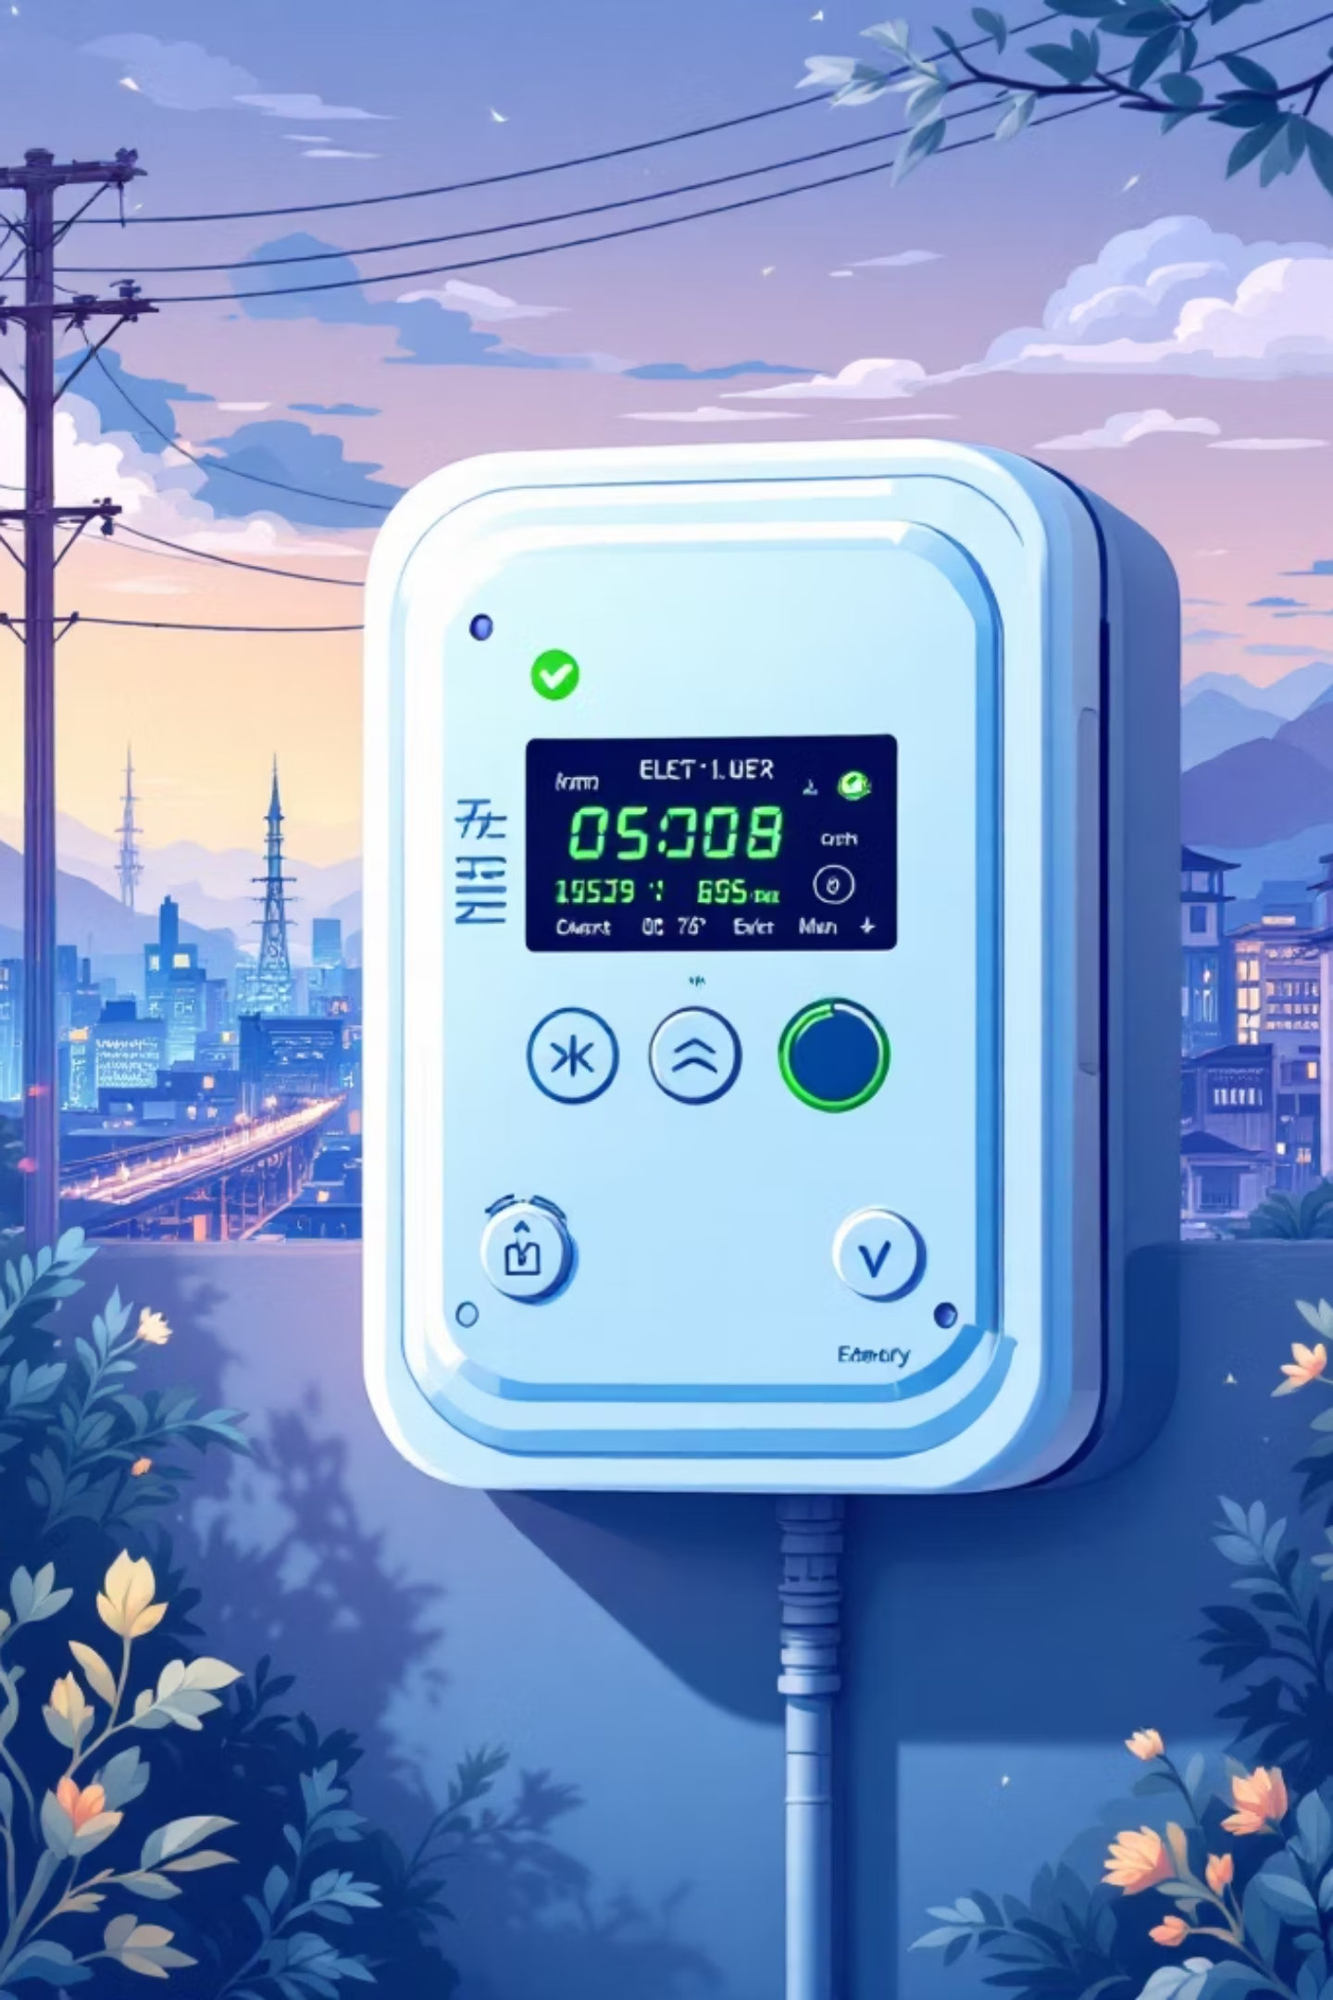
Carbon-Aware Automated Smart Grid Vending (BPDB / DESCO)
CSE407: Green Computing
Case Study 1

Slide 2



Team Members
Nura Alam Naim
Md. Mahamudur Rahman
Tamim Hasan Saykat
ID: 2022-3-60-123
ID: 2022-3-60-182
ID:2022-1-60-289

Slide 3

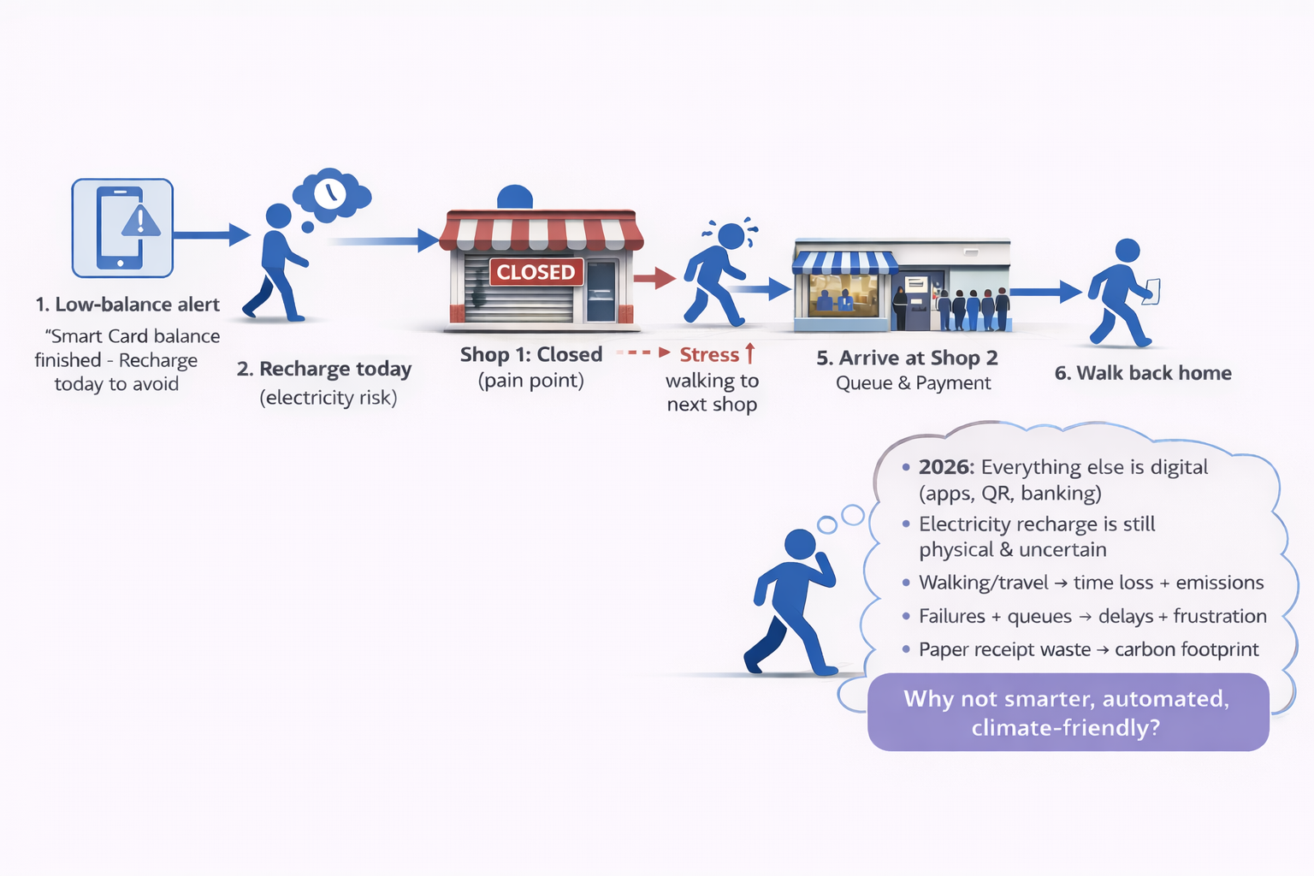
Problem Statement

Slide 4

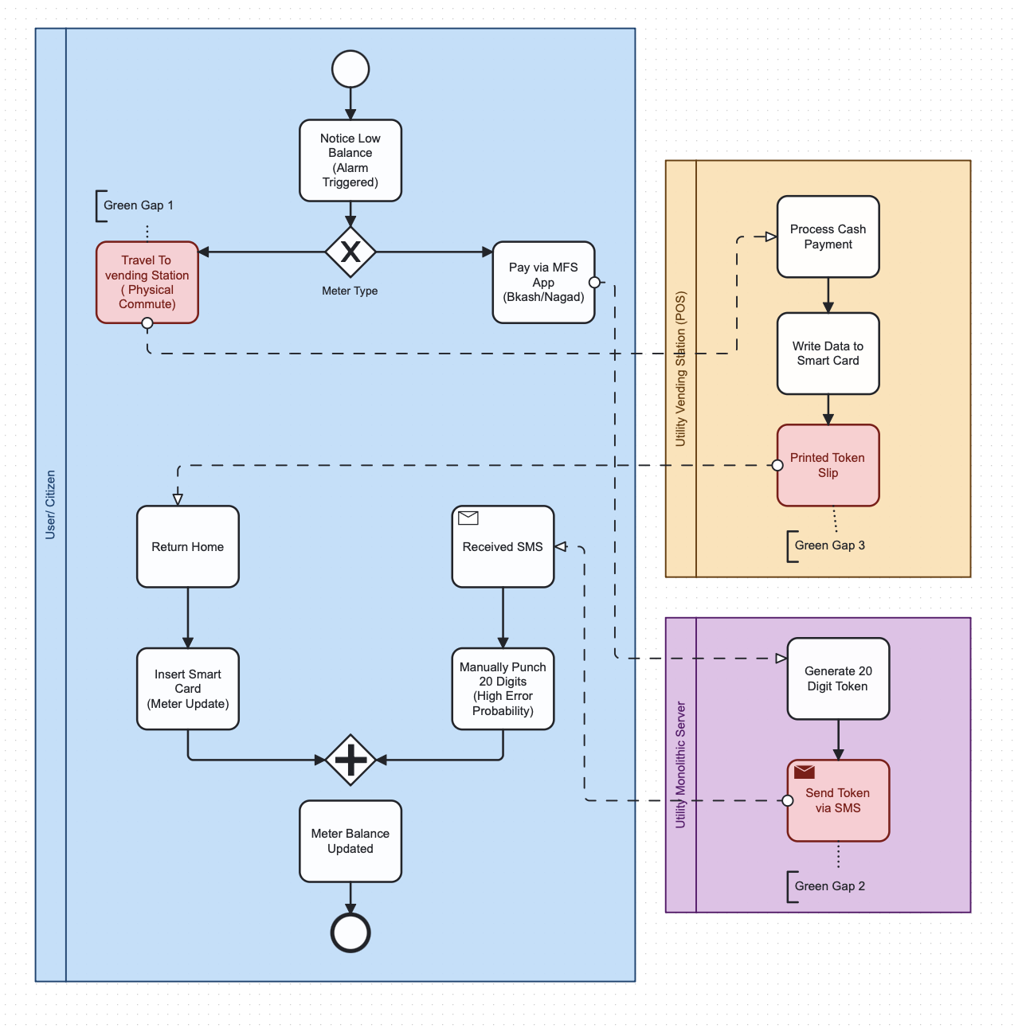
AS‑IS Model

Slide 5





Green Gaps in the Current System
Printed Paper
Material waste at POS: single-use slips, token cards, non-recyclable packaging.
Unnecessary Travel
Direct CO2 from consumer commutes for vending; time-energy inefficiency.
Server Idle Waste
Monolithic servers run 24/7, low utilization, persistent baseline power draw.
Cellular Network Overhead
SMS token mechanism creates high signaling overhead and redundant packets.

Slide 6
Waste in AS-IS (Quantitative Analysis)
Gap Category | Description | Energy (kWh) | CO2​ (kg) | Justification (Benchmark)
Travel | 50 users taking 4 km round trips | 30.0 | 17.79 | 0.15 kWh/km, 0.593 kg CO2/kWh
Servers | Always-on monolithic server idle waste (Allocated) | 15.0 | 8.89 | 150W idle for 24 hours.
Printing | 50 POS physical receipts printed | 2.5 | 1.73 | 0.05 kWh/page, 5g CO2 /page
Network | Heavy SMS API / Cellular TCP overhead | 1.0 | 0.59 | 0.02 kWh/transaction
Total | Combined Inefficiencies | 48.5 | 29 | Adjusted for Bangladesh Grid

Slide 7

TO‑BE Model: Carbon‑Aware IoT Automation

Slide 8
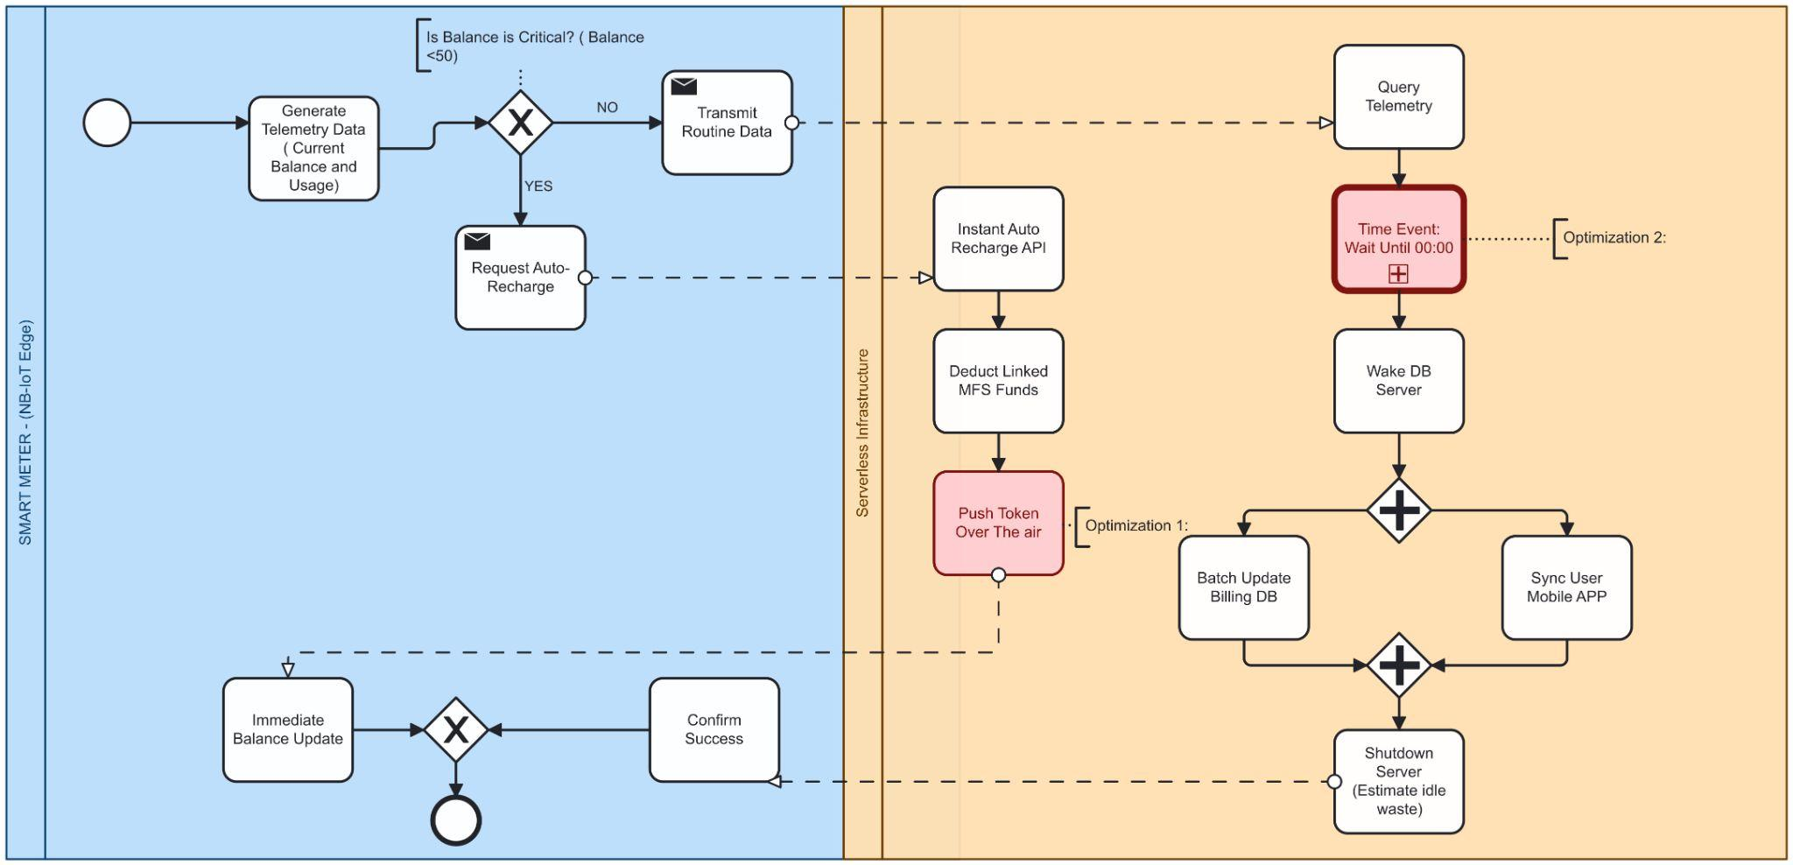
Proposed Green Initiatives — Technical Pillars

Slide 9
Proposed Green Initiatives — Technical Pillars
1. OTA Telemetry
2. Serverless Architecture
3. Carbon‑Aware Scheduling
Secure firmware and balance sync over encrypted channels — eliminates physical vending and paper tokens.
Event-driven compute (cold-start optimized) to remove 24/7 idle baseline; scale to demand.
BPMN Timer Events shift non-critical syncs to off‑peak grid carbon windows (e.g., 03:00 local time).
4. Parallel Execution
5. Smart Edge Triggers
AND‑gateways enable concurrent DB/app sync to reduce wall-clock time and transient energy use.
Edge filtering at IoT nodes to suppress redundant pings and only emit events on state deltas.

Slide 10
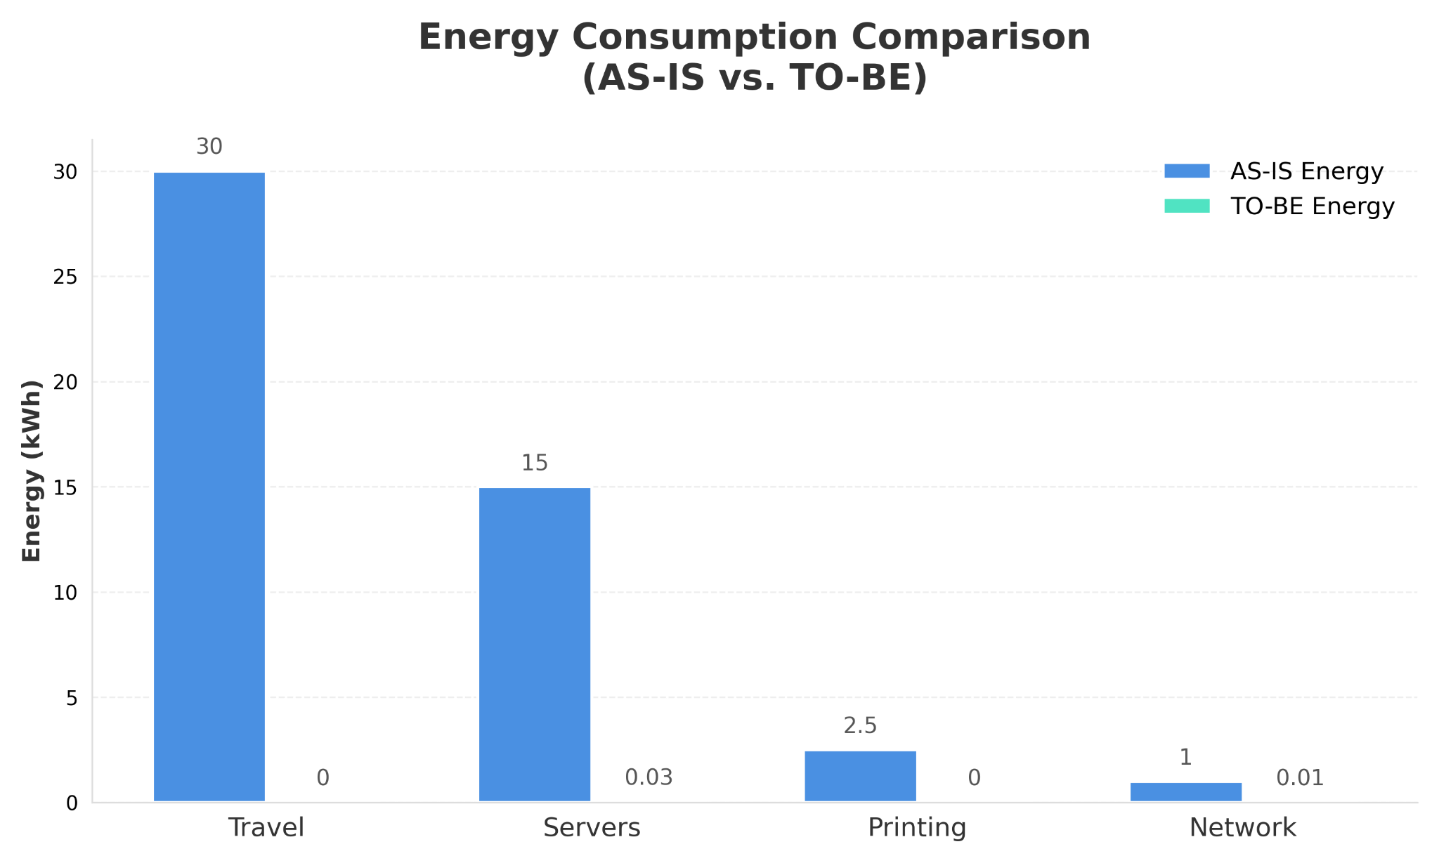
Comparison & Validation
Aspect | AS-IS Energy (kWh) | TO-BE Energy (kWh) | Savings (kWh) | CO2​ Savings (kg)
Travel | 30.0 (Commute to POS) | 0 (Automated IoT) | 30.0 | 17.79
Servers | 15.0 (Monolith 24/7 Idle) | 0.03 (100 * 0.0003 API) | 14.97 | 8.88
Printing | 2.5 (POS Receipts) | 0 (Digital Push) | 2.5 | 1.48
Network | 1.0 (Heavy SMS load) | 0.01 (Lightweight UDP) | 0.99 | 0.58
Total | 48.5 | 0.04 | 48.46 | 28.73

Slide 11


